Slide 2
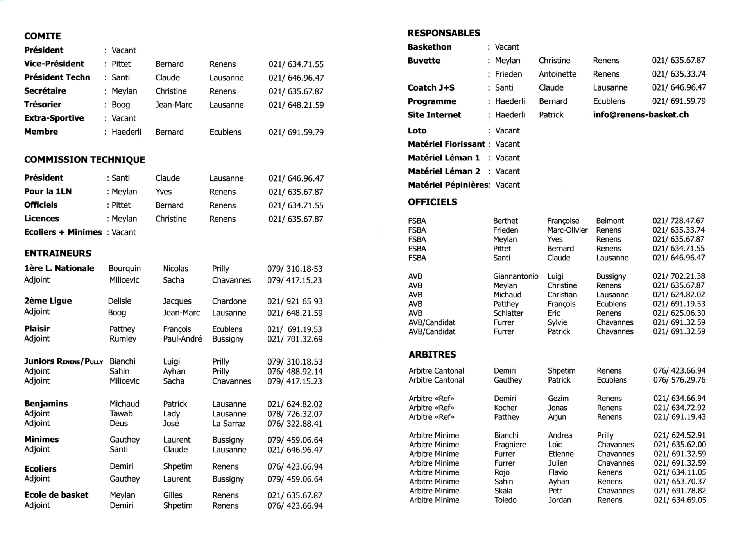

Slide 5
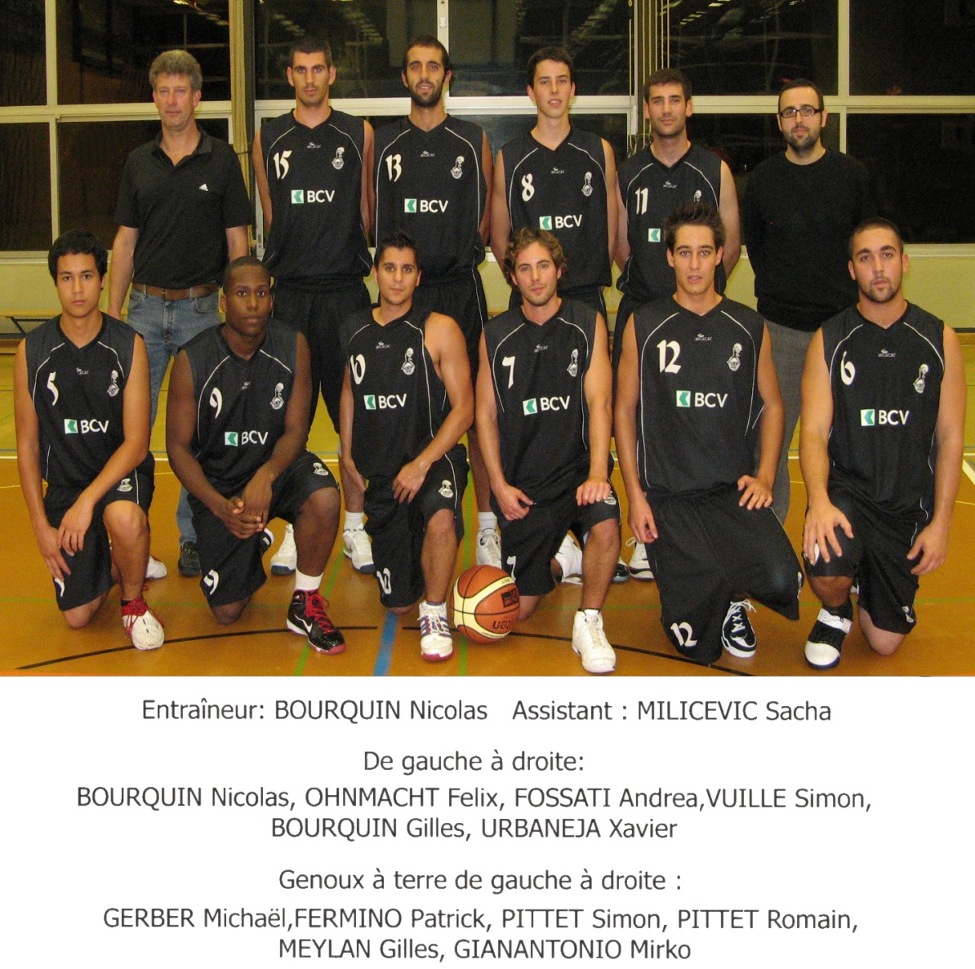
Renens I 1LNM
2009
2010

Slide 6
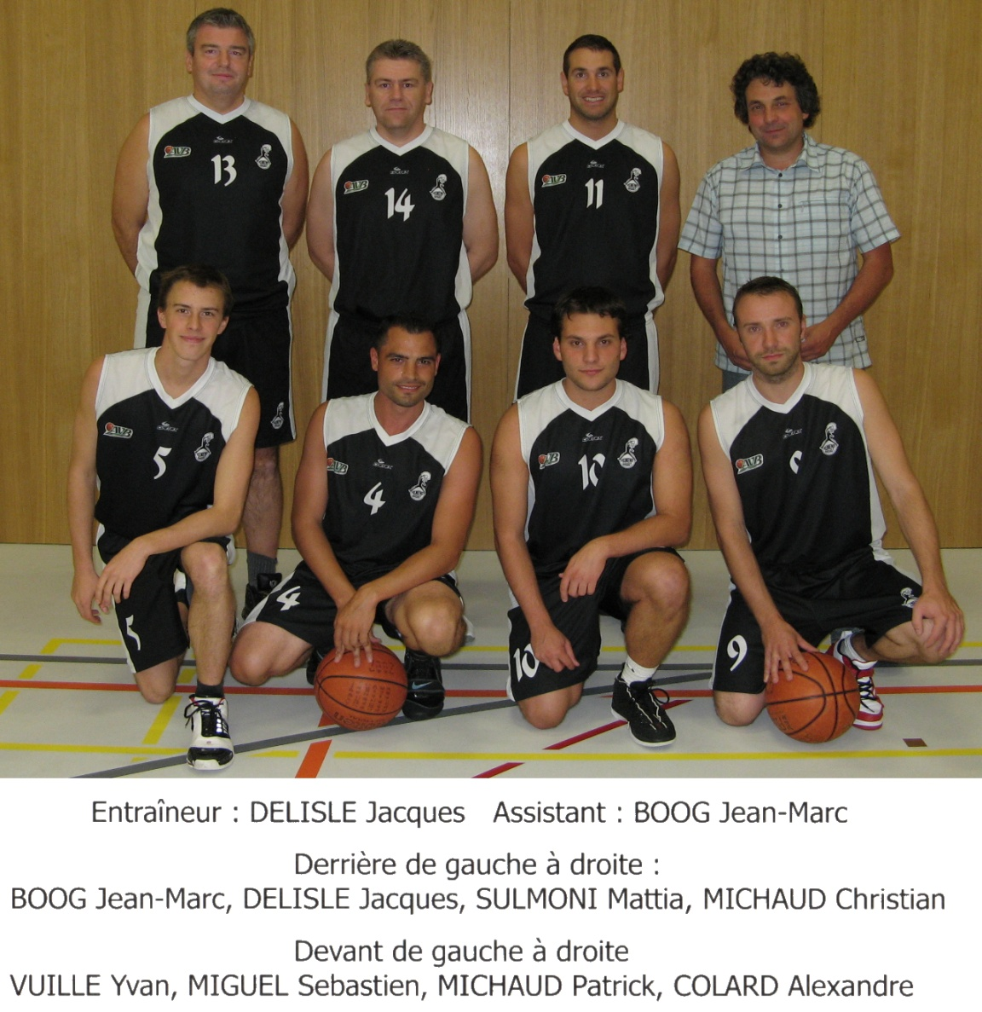
Renens II 2ème Ligue
2009
2010

Slide 7
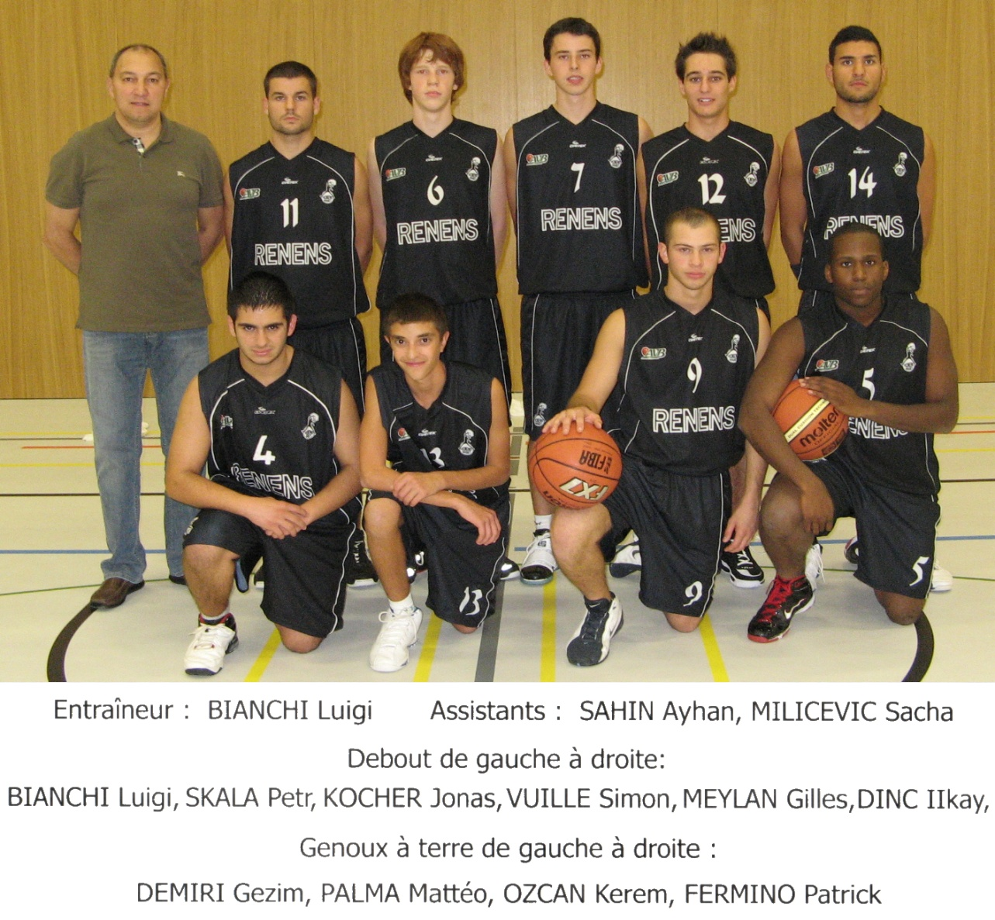
Juniors Renens-Pully
2009
2010

Slide 8
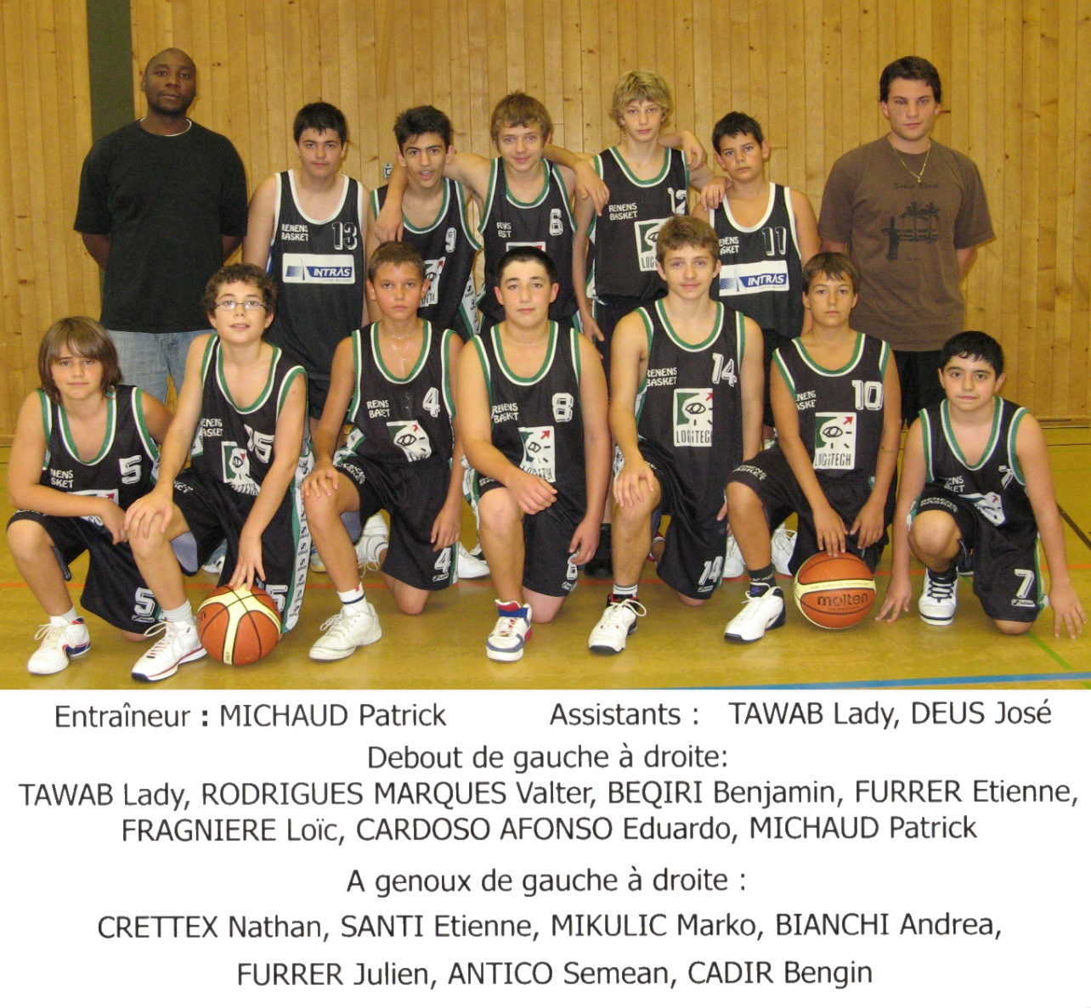
Benjamins Renens-Pully
2009
2010

Slide 9
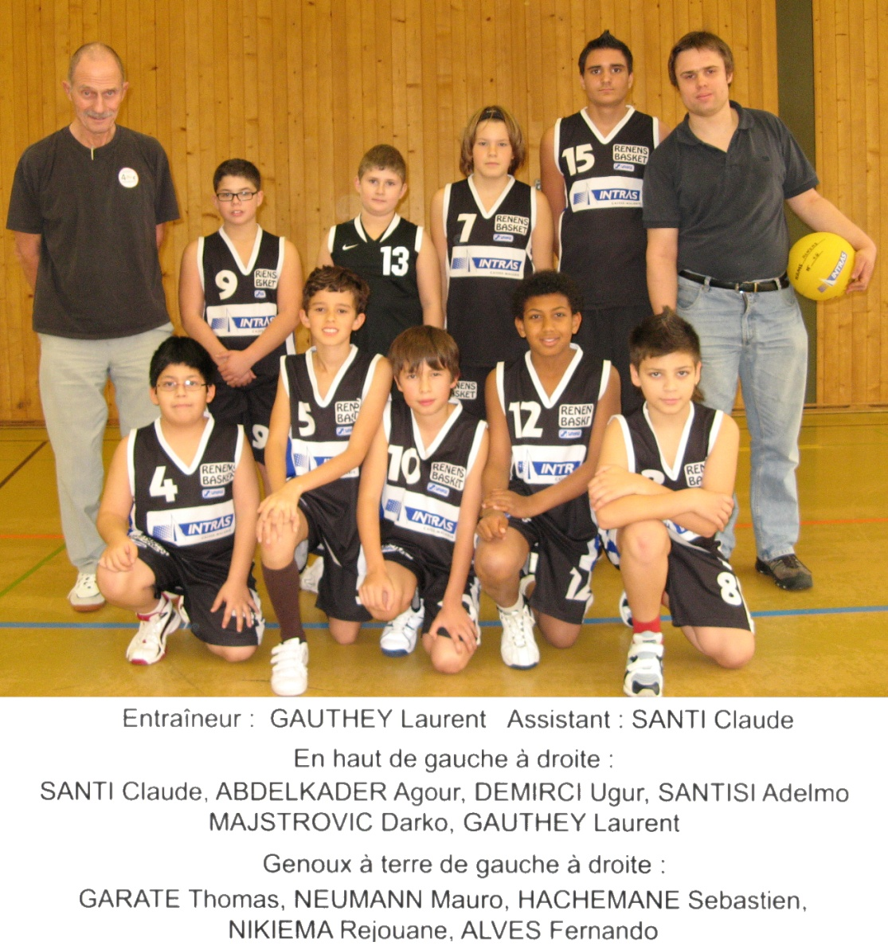
Minimes
2009
2010

Slide 10
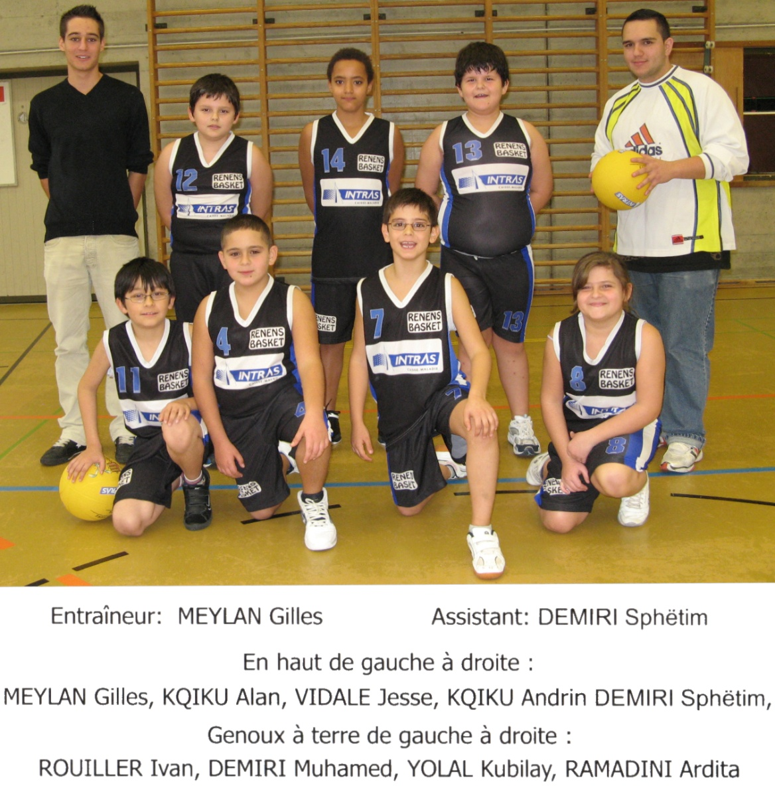
Ecoliers
2009
2010

Slide 11
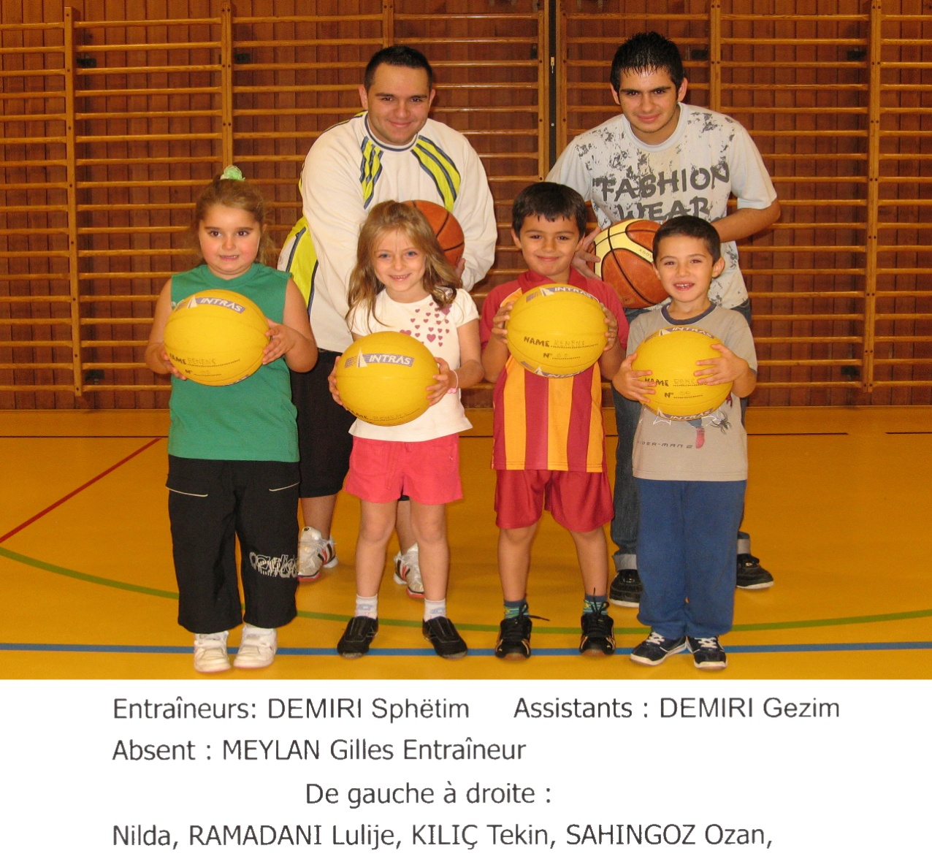
Ecole de Basket
2009
2010

