Slide 1
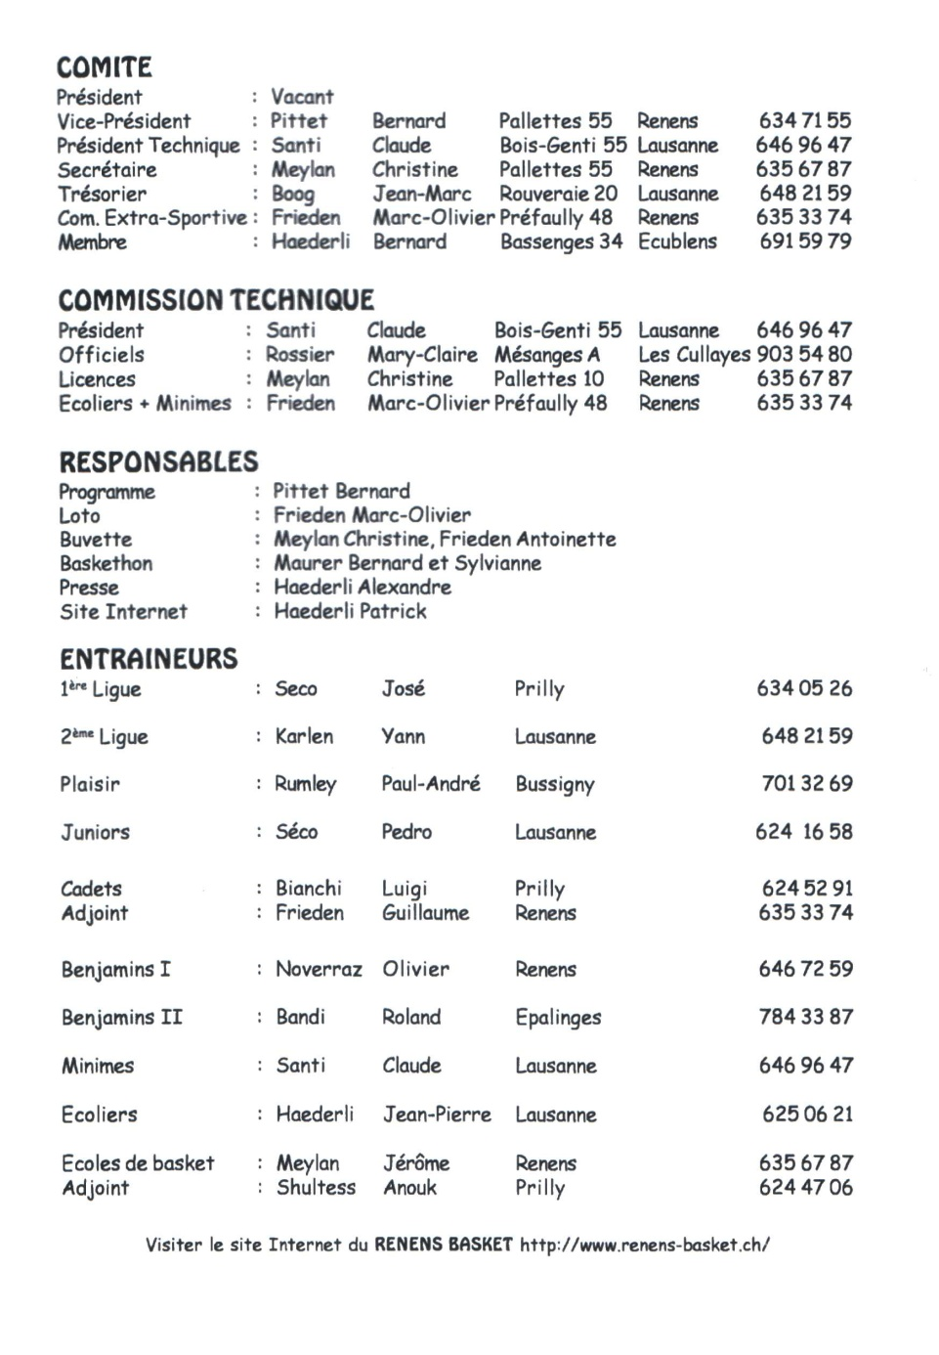

Slide 2
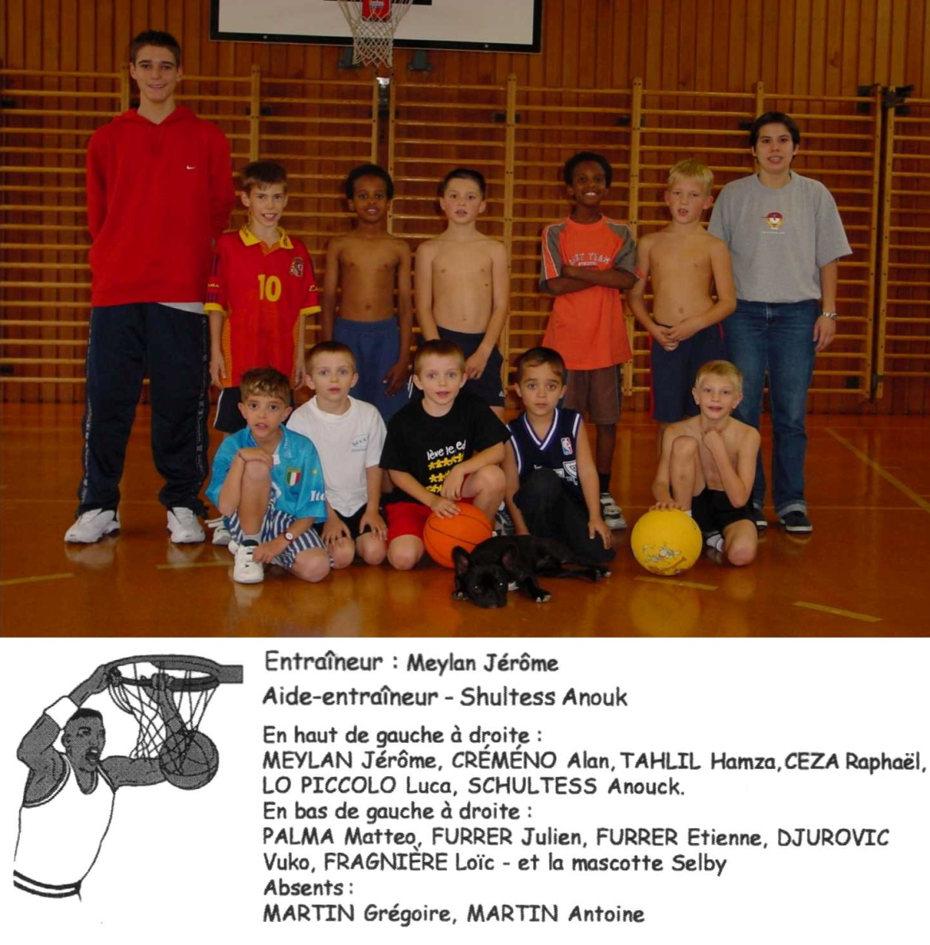
2002
2003
Ecole de Basket

Slide 3
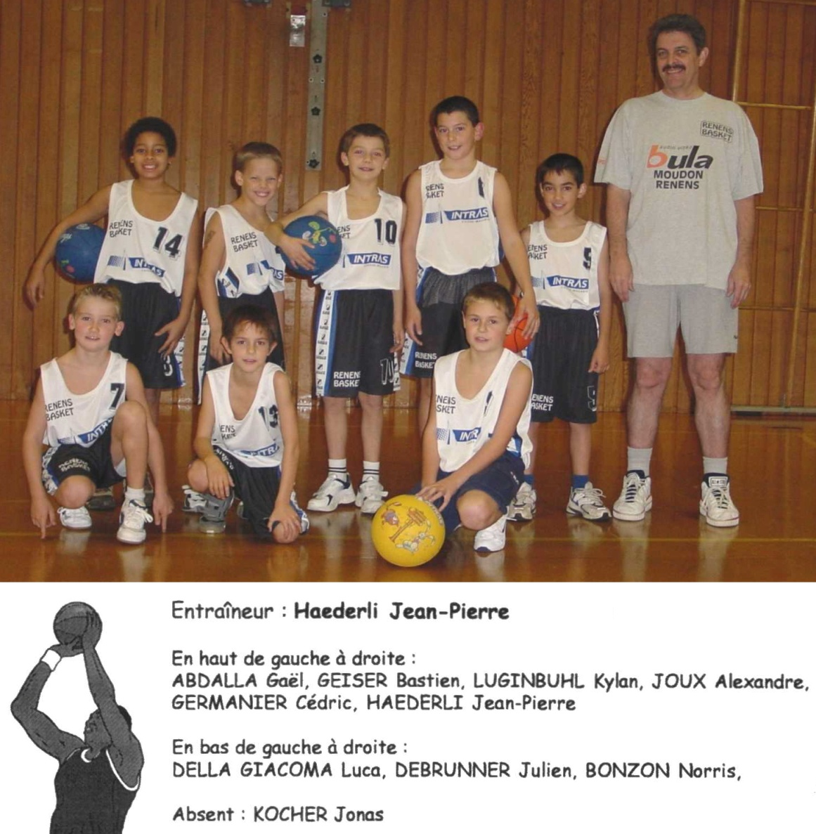
2002
2003
Ecoliers

Slide 4
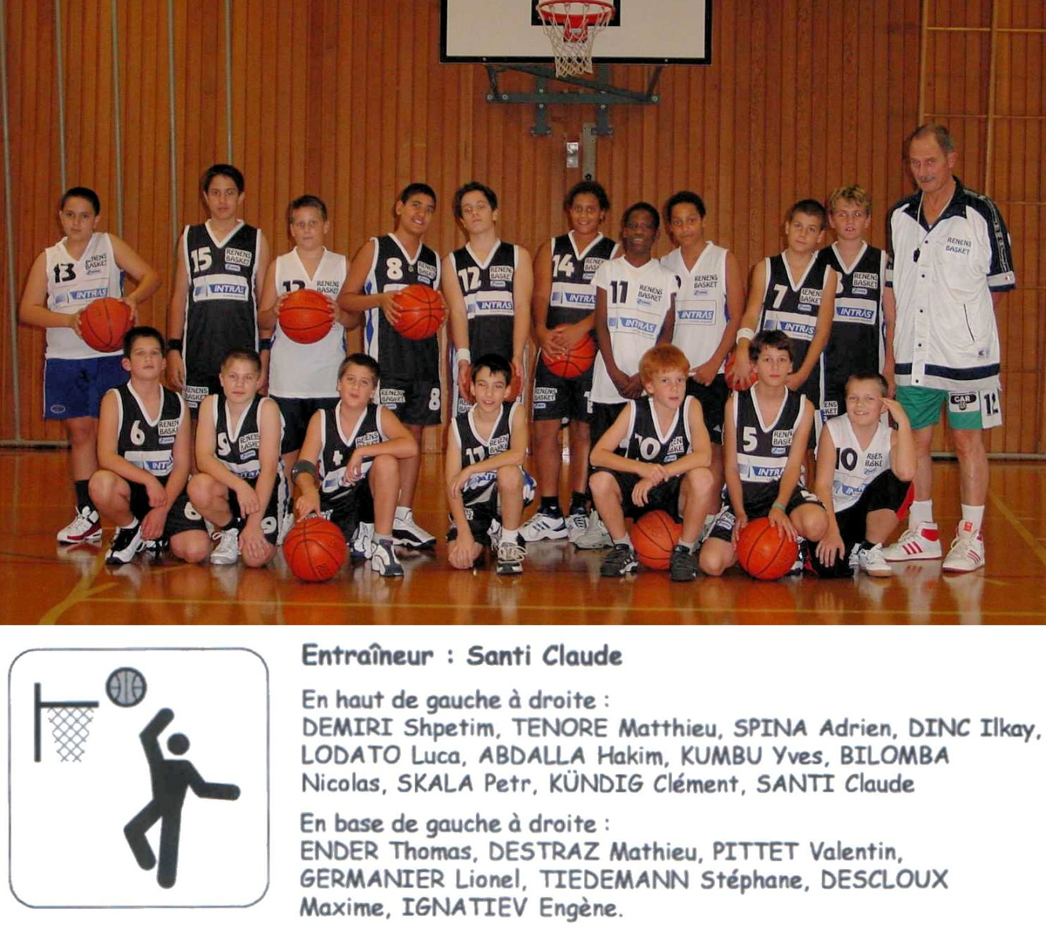
2002
2003
Minimes

Slide 5
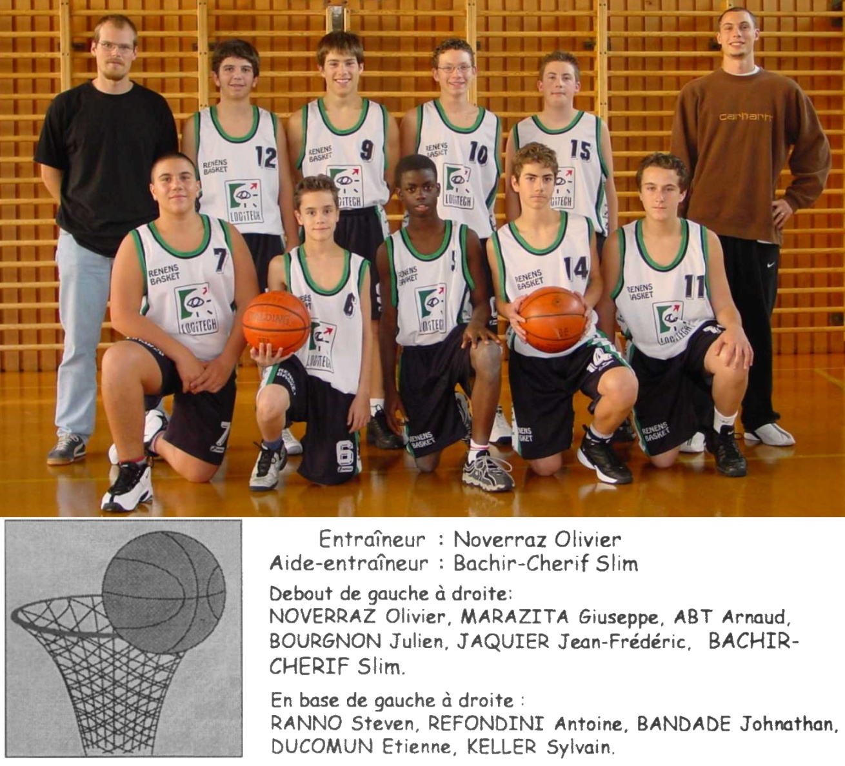
2002
2003
Benjamins 1

Slide 6
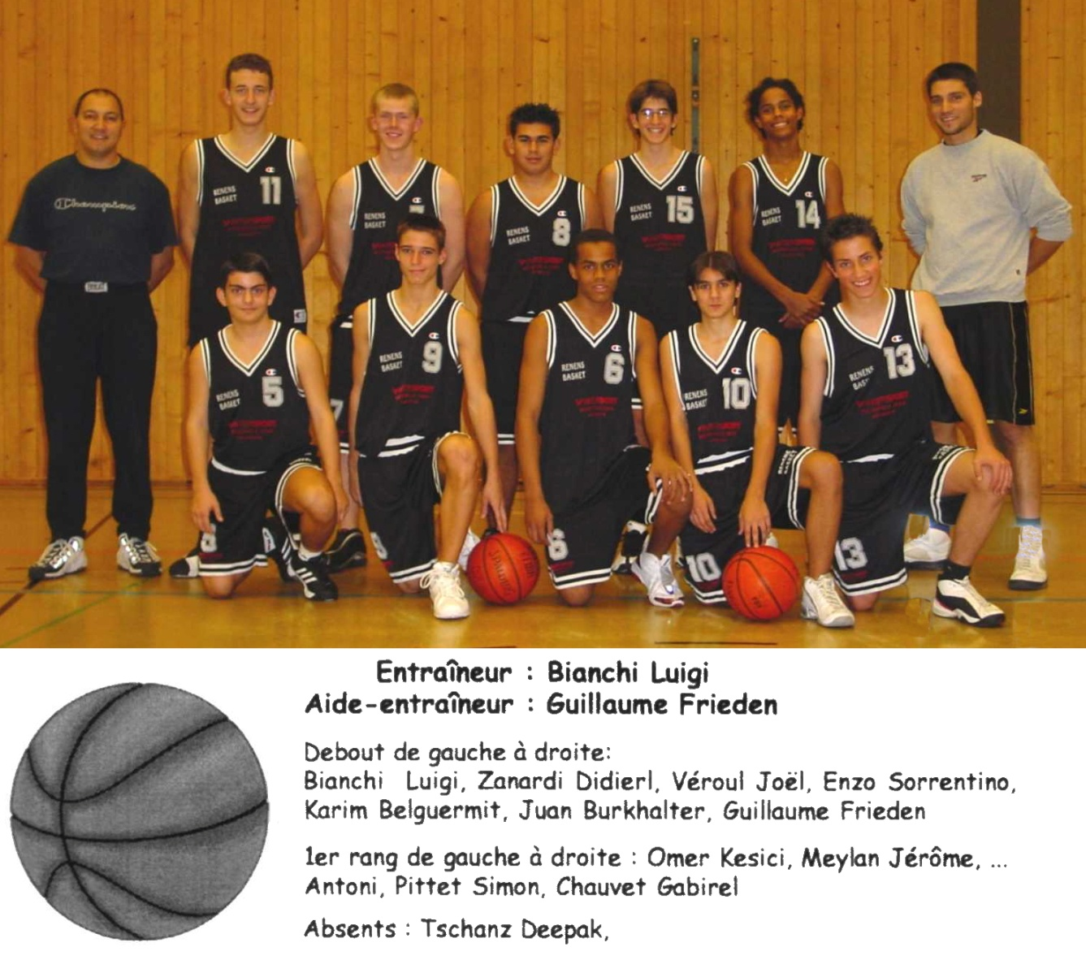
2002
2003
Cadets

Slide 7
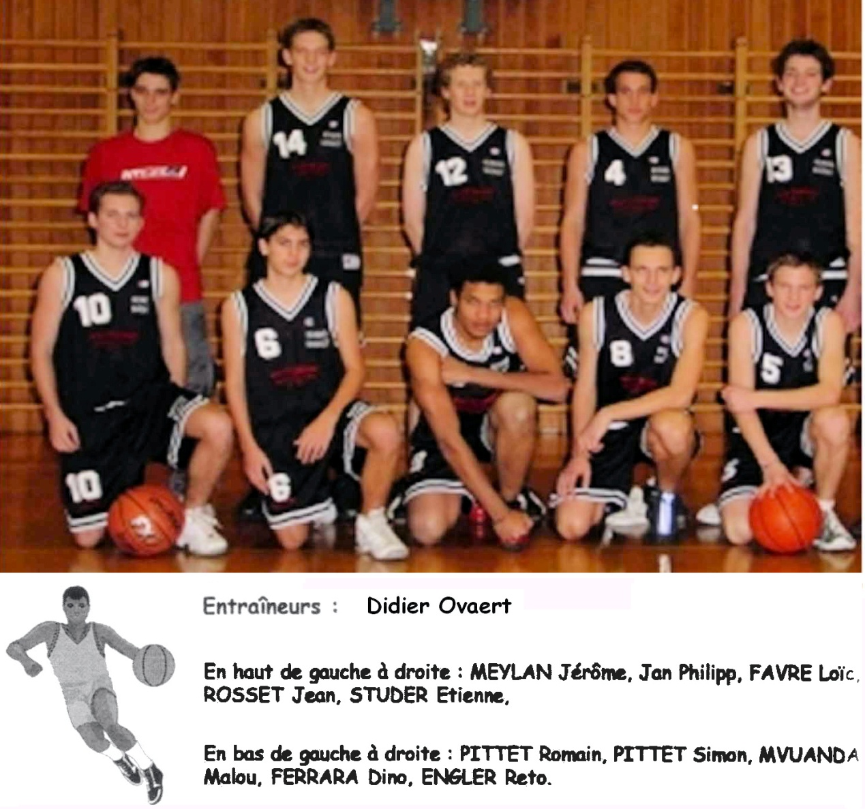
2002
2003
Juniors

Slide 8
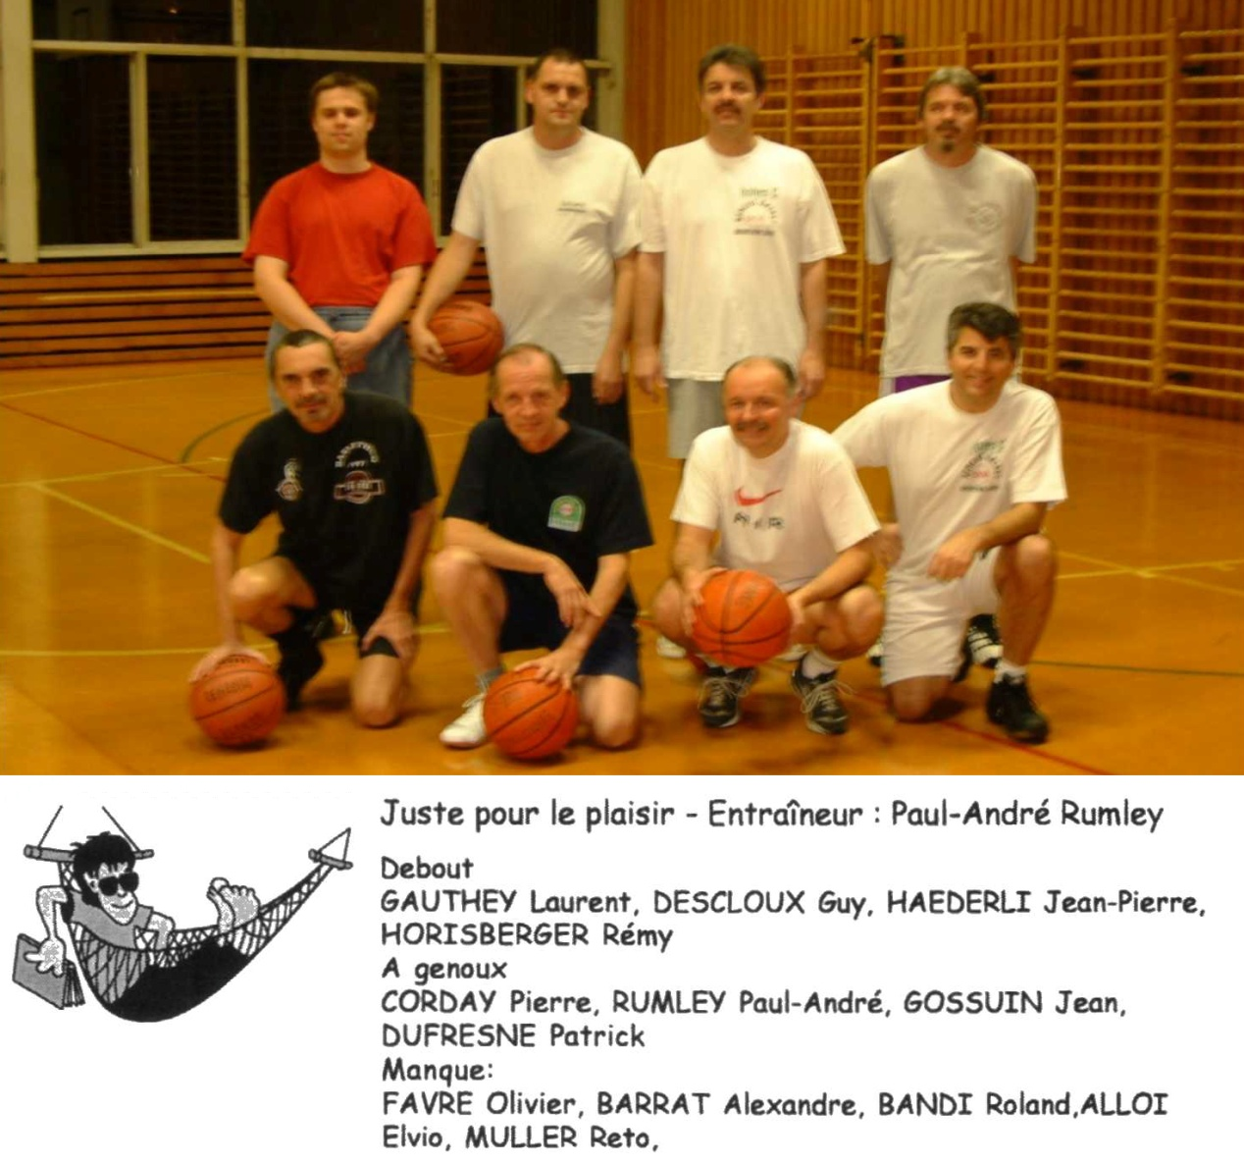
2002
2003
Renens Plaisir

